Slide 1
Towards the development of a National Microbiome Data Collaborative
Emiley Eloe-Fadrosh
Metagenome Program Head
May 2, 2018

Slide 2
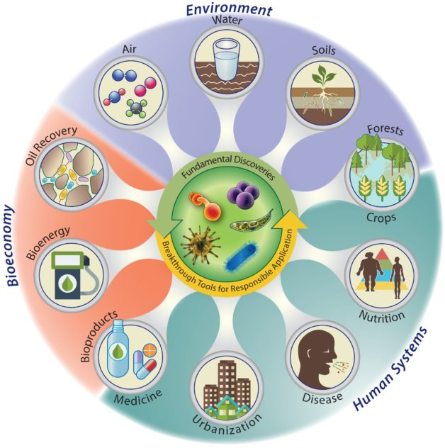
National Microbiome Initiative
Launched in 2016
Target areas:
Supporting interdisciplinary research
Developing platform technologies
Expanding the microbiome workforce
One critical – and truly unifying – component yet to emerge is a coordinated proposal in support of microbiome data infrastructure.
Blaser et al. mBio 2016; doi:10.1128/mBio.00714-16

Slide 3



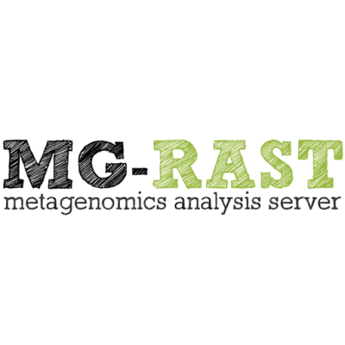



Fundamental blueprint: DNA sequence
Data is fragmented, compartmentalized and siloed
Major challenges to replicate, reuse and build on findings to translate sequence data into discovery

Slide 4
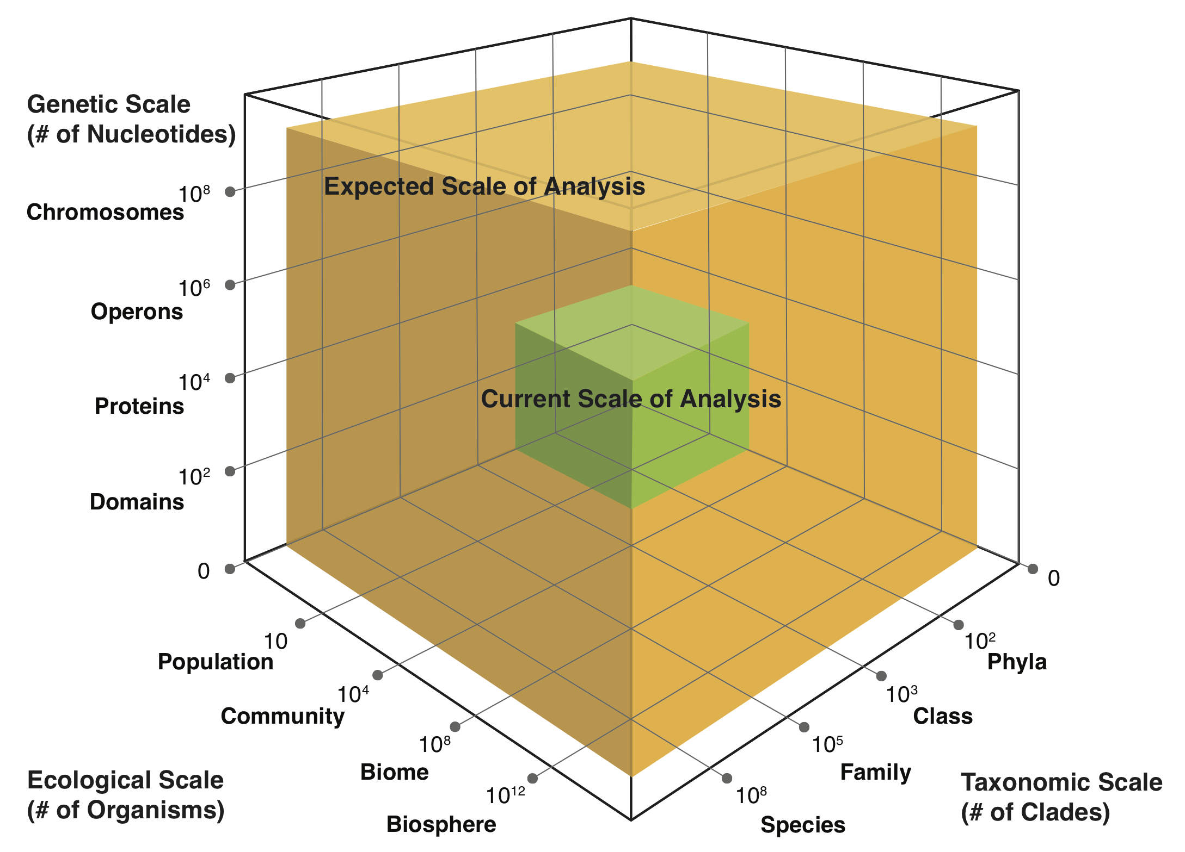
A flood of microbiome data
Tremendous growth of microbiome data
Courtesy of Guy Cochrane (ENA/INSDC)
Advances in DNA sequencing and related ‘omics technologies have far outpaced our infrastructure for collecting, processing, and distributing this information in an effective and uniform way.

Slide 5
What grand challenges could be tackled
if we harness this scale of data?

Slide 6
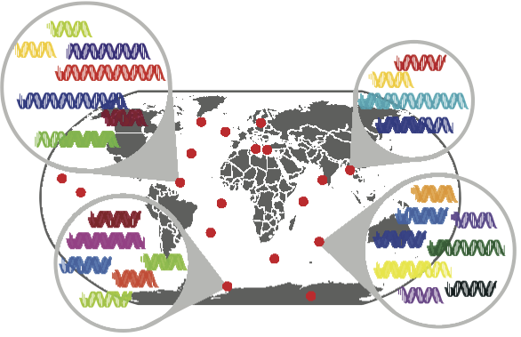
Identifying taxonomic ‘blind spots’
Primer mismatches
primer
16S
primer
primer
primer
primer
primer
primer
primer
primer
primer
At least ~10% of environmental sequences might not be recovered using a targeted PCR survey
primer
primer
Search globally across metagenomic datasets
‘blind spot’
2016

Slide 7
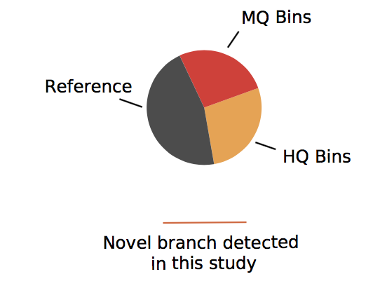


Evaluating taxonomic ‘blind spots’ at scale
Bacteria
Frederik Schulz
Sean Jungbluth

Slide 8
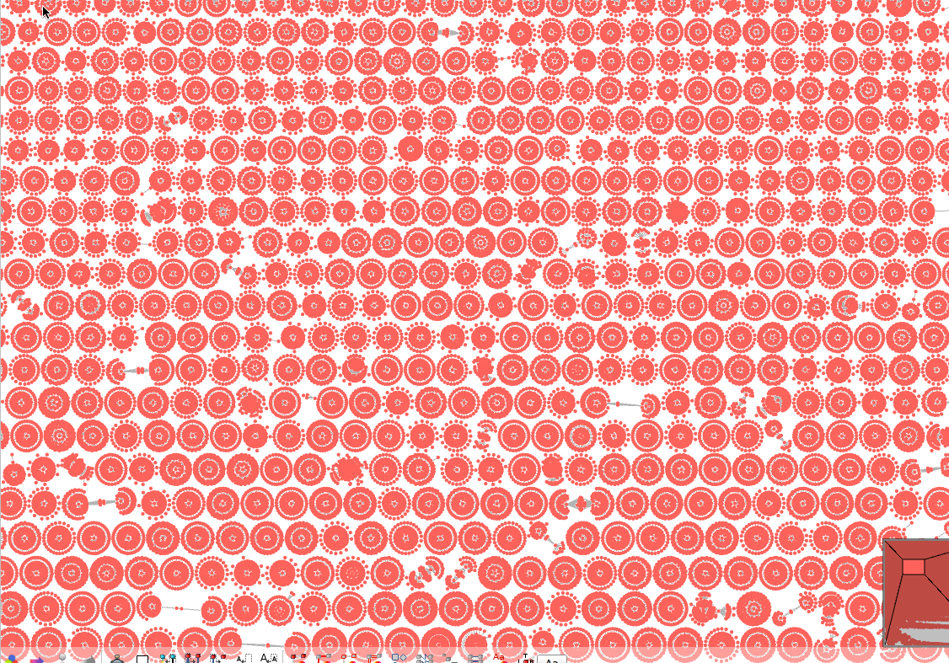
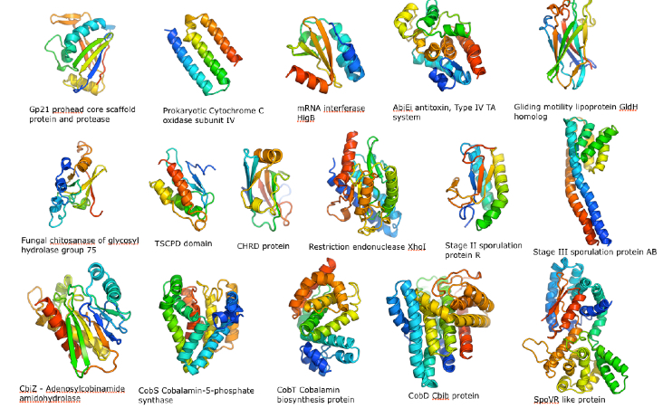
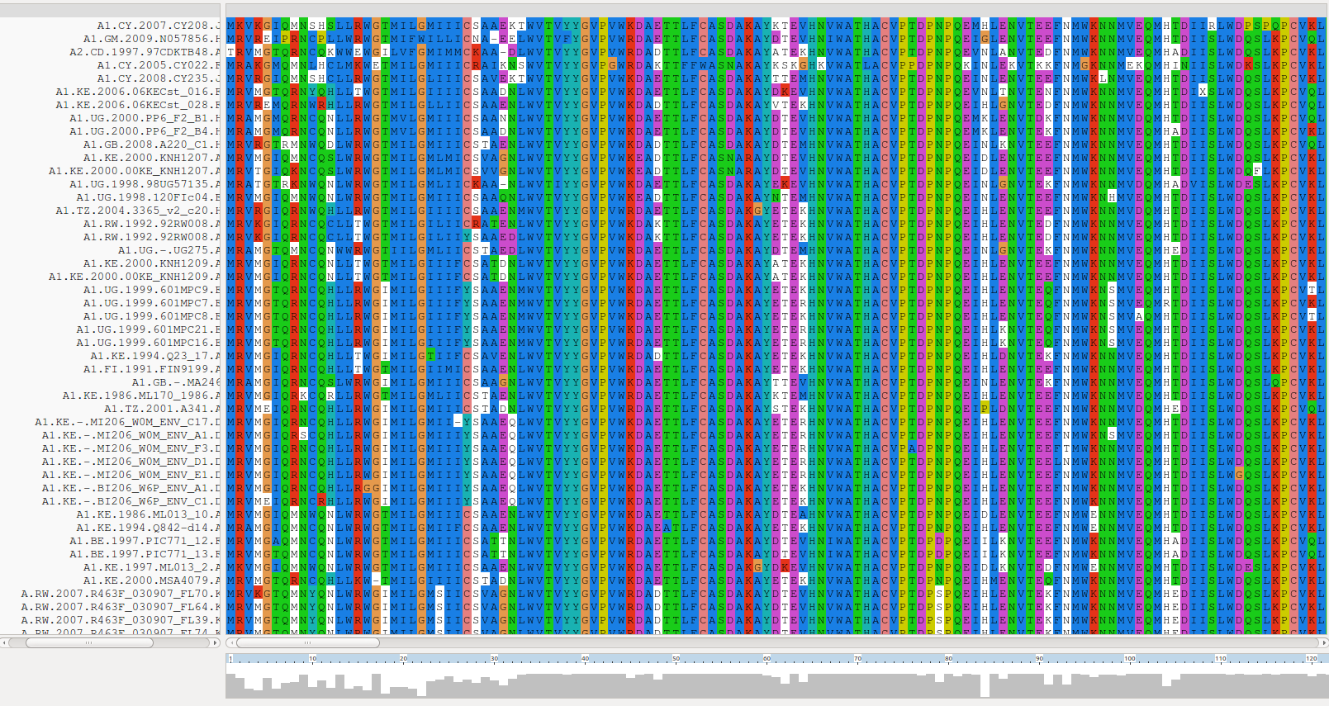


Protein structure predictions
Discovery of novel structures using metagenomic data
No Structural
Predictions
612 novel
structures (12%)
Known
Structures
Structural
Predictions
available
Metagenome enrichment

Slide 9
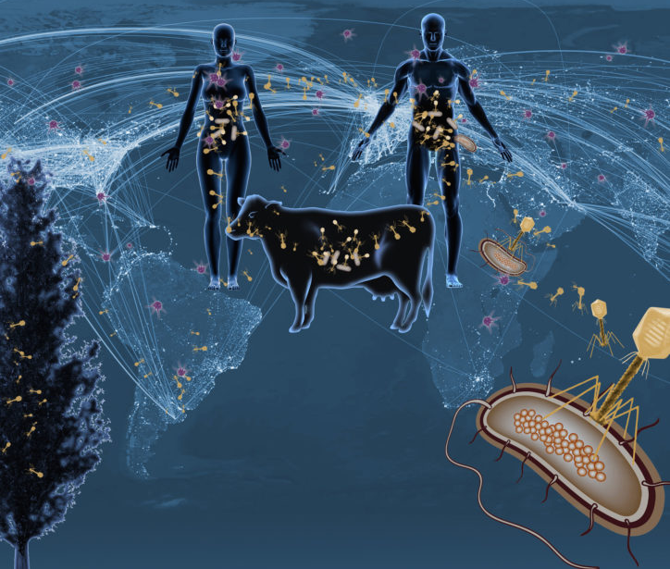

Viral diversity at ecosystem scales
Analyzed 5 TB of metagenomic data
Identified 125,000 partial DNA viral genomes
Increased number of viral genes by 16-fold
Linked viruses to putative host using CRISPRs and tRNAs
Revealed global viral biogeography

Slide 10

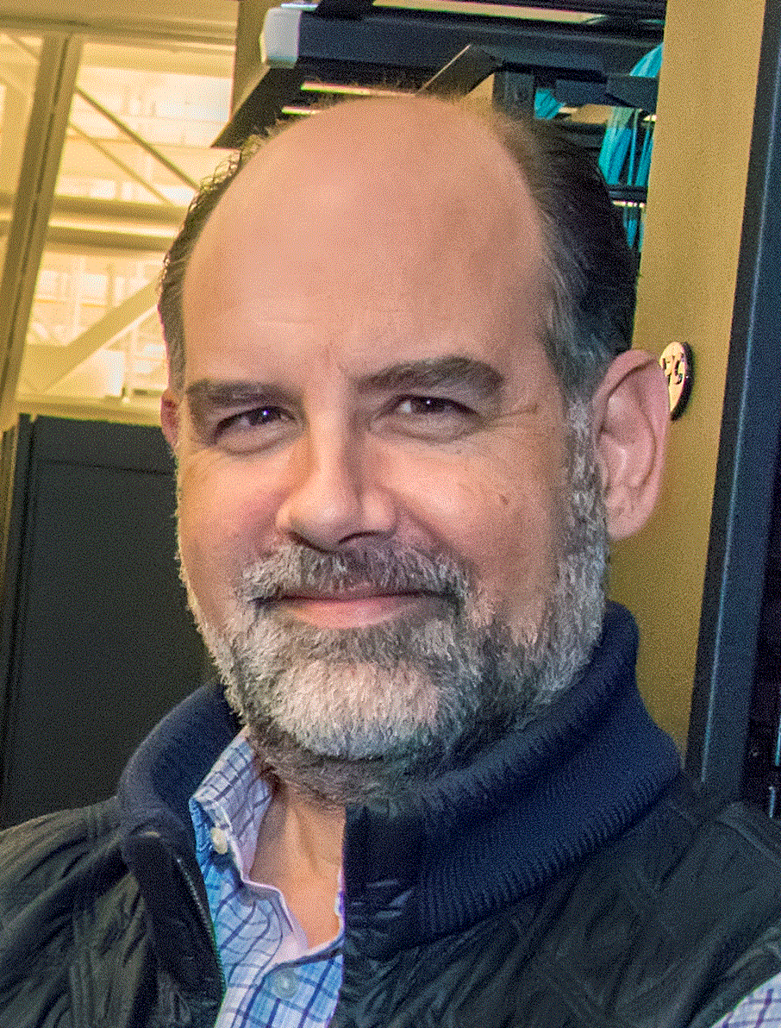
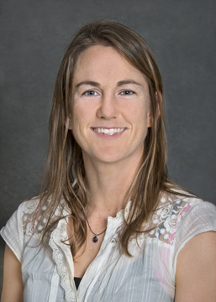

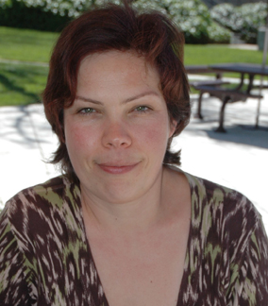
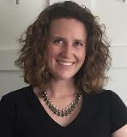

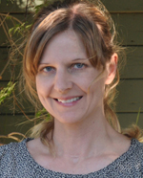
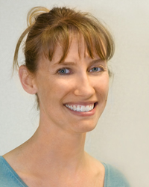
Microbiome Data Science FICUS
Biogeochemical anchor genes
Environmental enzyme superfamilies
Novel eukaryotic protein structures
Novel classification methods
Mapping soil population genomes
Global catalog of small RNAs
Notes:
As Susannah and Nikos already mentioned, this is a new program to enable access to computational resources, data and expertise in microbial genomics and metagenomics. Here is a snapshot of the 6 projects that were supported this first round, and gives an idea of the breadth of research this new program supports, encompassing large-scale mining for small RNAs, cataloguing biogeochemical anchor genes, and developing new metagenomic classification methods. As Susannah mentioned, we have successfully initiated all projects and pilot projects are currently underway. We are really excited about the outputs for these projects and how this will further leverage resources and capabilities at both JGI and NERSC.

Slide 11

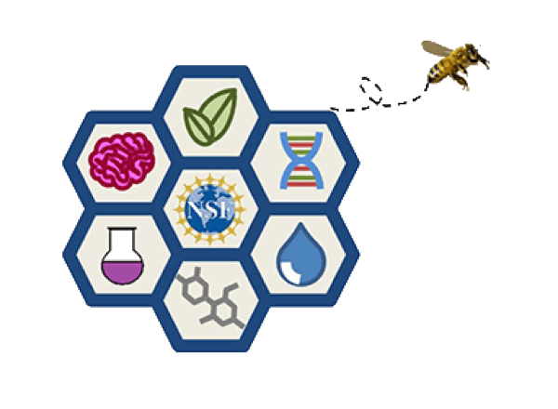







Enable the integration of a coordinated archive of all microbiome data to enhance discovery and analysis.

Slide 12
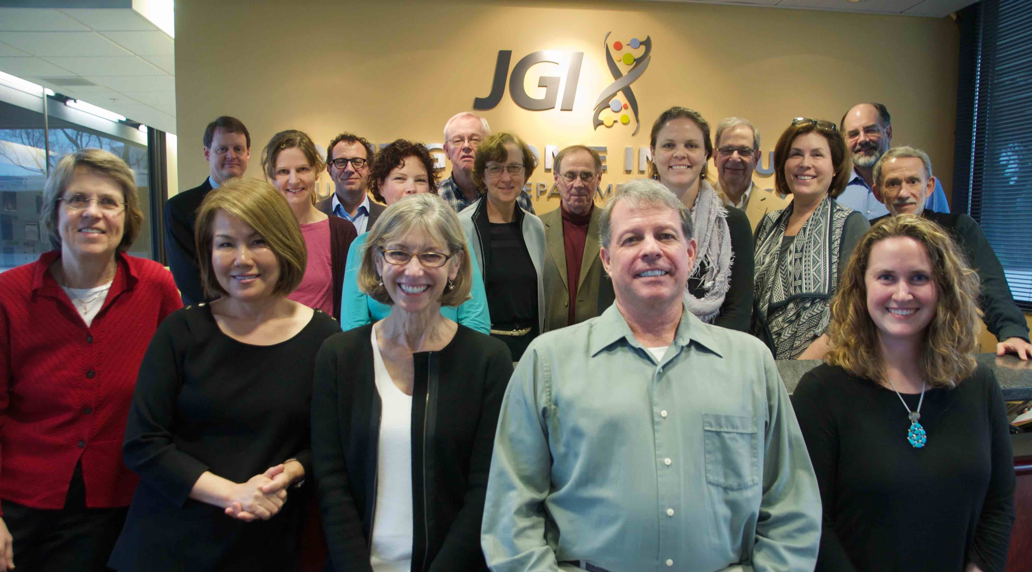


First workshop at the JGI
Charge: Develop a vision for microbiome data science that would enable a long-term microbiome data infrastructure strategy
National Microbiome Data Collaborative Workshop
Joint Genome Institute, February 6-7, 2017
Chairs: Claire Fraser and Ed DeLong
Organizers: Nikos Kyrpides,
Emiley Eloe-Fadrosh, Mary Maxon
Notes:
In order to do the large-scale data mining and inferences of microbe-microbe interactions, we need the appropriate infrastructure. This is an issue near and dear to my heart, and something I have been championing even before I joined JGI when I was at the Gordon and Betty Moore Foundation. Microbiome research has become increasingly data-driven, and in order to really move the field forward we need to develop and coordinate a distributed, integrated data collaborative. At JGI, we talk about these issues on a daily basis in the context of how to manage the IMG system, how to scale the infrastructure we have to enable the science across a large, diverse research community. We came out with a commentary last year from our observations, and have been actively involved in how to push forward the need to develop a national microbiome data collaborative. We held a workshop earlier this year with a small group of leaders in the field, chaired by Claire Fraser and Ed DeLong, and the spurred a townhall meeting to be held a the upcoming ASM-Microbe meeting and a colloquium later this year hosted by the American Academy of Microbiology and ASM.

Slide 13

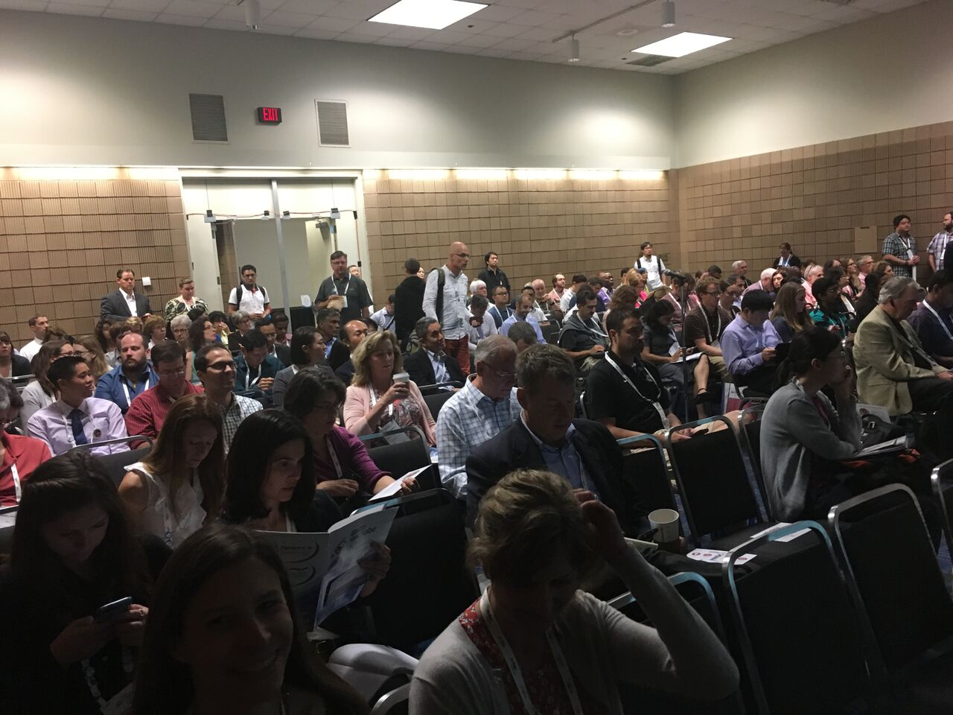
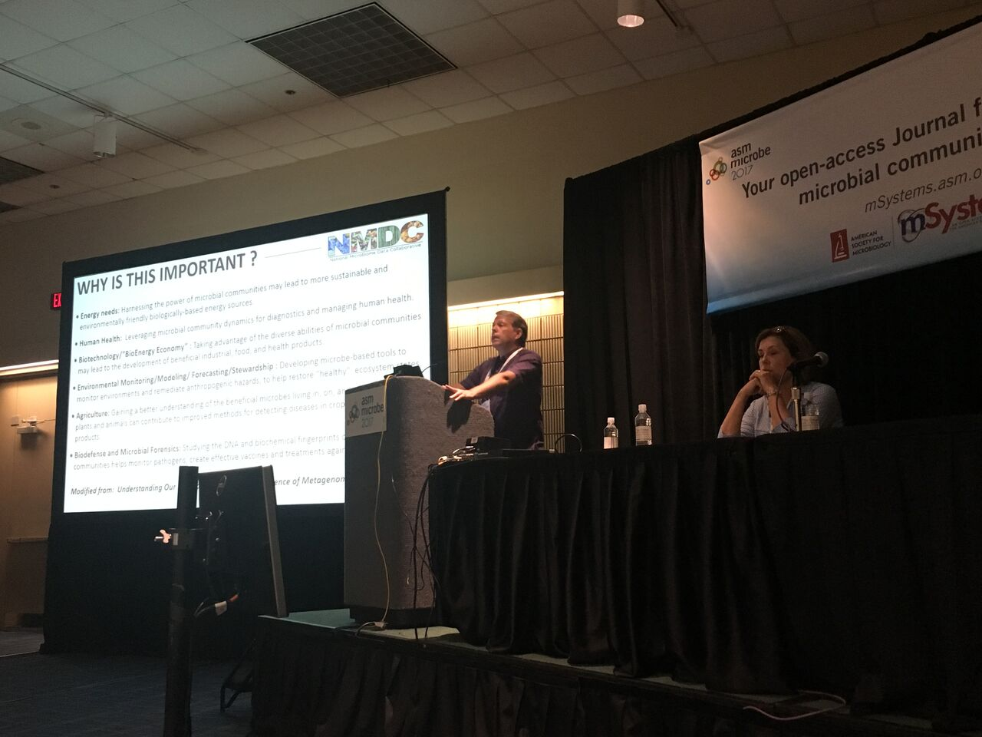
Town Hall to engage broader community
300+ attendees from diverse backgrounds (grad students, faculty, industry, government agencies, federal funders and private foundation reps)
Notes:
In order to do the large-scale data mining and inferences of microbe-microbe interactions, we need the appropriate infrastructure. This is an issue near and dear to my heart, and something I have been championing even before I joined JGI when I was at the Gordon and Betty Moore Foundation. Microbiome research has become increasingly data-driven, and in order to really move the field forward we need to develop and coordinate a distributed, integrated data collaborative. At JGI, we talk about these issues on a daily basis in the context of how to manage the IMG system, how to scale the infrastructure we have to enable the science across a large, diverse research community. We came out with a commentary last year from our observations, and have been actively involved in how to push forward the need to develop a national microbiome data collaborative. We held a workshop earlier this year with a small group of leaders in the field, chaired by Claire Fraser and Ed DeLong, and the spurred a townhall meeting to be held a the upcoming ASM-Microbe meeting and a colloquium later this year hosted by the American Academy of Microbiology and ASM.

Slide 14
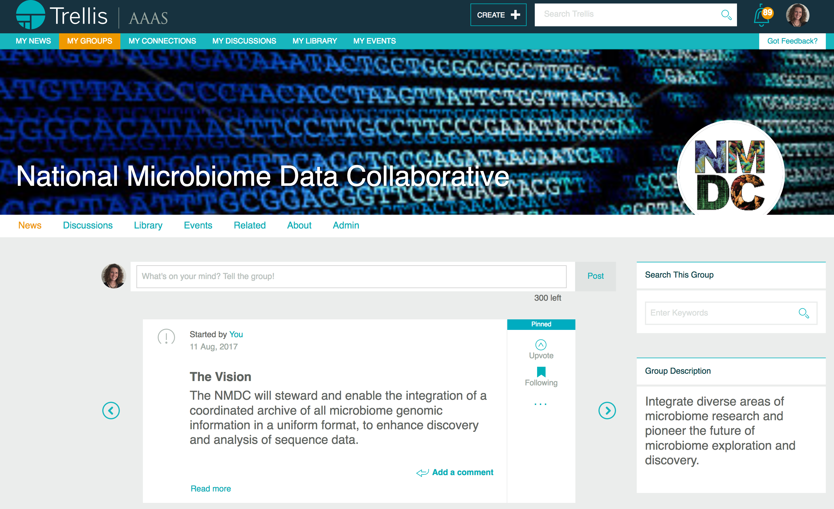
Broad, inclusive digital community
100+ members
http://www.trelliscience.com/NMDC/
Notes:
In order to do the large-scale data mining and inferences of microbe-microbe interactions, we need the appropriate infrastructure. This is an issue near and dear to my heart, and something I have been championing even before I joined JGI when I was at the Gordon and Betty Moore Foundation. Microbiome research has become increasingly data-driven, and in order to really move the field forward we need to develop and coordinate a distributed, integrated data collaborative. At JGI, we talk about these issues on a daily basis in the context of how to manage the IMG system, how to scale the infrastructure we have to enable the science across a large, diverse research community. We came out with a commentary last year from our observations, and have been actively involved in how to push forward the need to develop a national microbiome data collaborative. We held a workshop earlier this year with a small group of leaders in the field, chaired by Claire Fraser and Ed DeLong, and the spurred a townhall meeting to be held a the upcoming ASM-Microbe meeting and a colloquium later this year hosted by the American Academy of Microbiology and ASM.

Slide 15

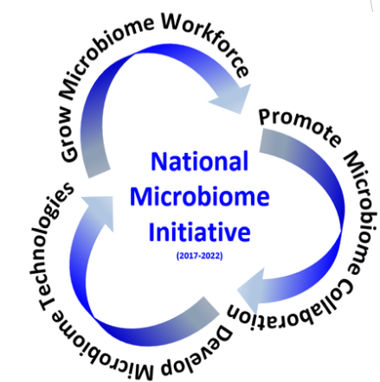
NMDC stakeholder workshop
American Society for Microbiology
November 9 - 10, 2017
Organizers:
Ed DeLong, University of Hawaii
Claire Fraser, Institute for Genome Sciences, University of Maryland
Bob Cottingham
Kim Pruitt
Folker Meyer
Owen White
Bonnie Hurwitz
Nikos Kyrpides
Microbiome Interagency Working Group Overview
Sharlene Weatherwax, DOE BER
Panel Discussion: Science and Agency Perspectives
Mary Ann Moran, University of Georgia Jennifer Wortman, Seres Therapeutics
Jim Tiedje, Michigan State University Todd Anderson, DOE BER
Lita Proctor, NIH
Notes:
In order to do the large-scale data mining and inferences of microbe-microbe interactions, we need the appropriate infrastructure. This is an issue near and dear to my heart, and something I have been championing even before I joined JGI when I was at the Gordon and Betty Moore Foundation. Microbiome research has become increasingly data-driven, and in order to really move the field forward we need to develop and coordinate a distributed, integrated data collaborative. At JGI, we talk about these issues on a daily basis in the context of how to manage the IMG system, how to scale the infrastructure we have to enable the science across a large, diverse research community. We came out with a commentary last year from our observations, and have been actively involved in how to push forward the need to develop a national microbiome data collaborative. We held a workshop earlier this year with a small group of leaders in the field, chaired by Claire Fraser and Ed DeLong, and the spurred a townhall meeting to be held a the upcoming ASM-Microbe meeting and a colloquium later this year hosted by the American Academy of Microbiology and ASM.

Slide 16
The NMDC Roadmap
2017
First NMDC workshop at JGI (February)
2017
ASM Town Hall (June)
2017
Stakeholder workshop at ASM Headquarters, Washington DC (November)
2018
Establish NMDC steering committee for NSF Research Coordination Network proposal (May)
2018
NMDC stakeholder workshop report submitted for publication (March)
2018
With NSF RCN funding, establish working groups, management structure, and milestones to begin implementing NMDC vision
Notes:
In order to do the large-scale data mining and inferences of microbe-microbe interactions, we need the appropriate infrastructure. This is an issue near and dear to my heart, and something I have been championing even before I joined JGI when I was at the Gordon and Betty Moore Foundation. Microbiome research has become increasingly data-driven, and in order to really move the field forward we need to develop and coordinate a distributed, integrated data collaborative. At JGI, we talk about these issues on a daily basis in the context of how to manage the IMG system, how to scale the infrastructure we have to enable the science across a large, diverse research community. We came out with a commentary last year from our observations, and have been actively involved in how to push forward the need to develop a national microbiome data collaborative. We held a workshop earlier this year with a small group of leaders in the field, chaired by Claire Fraser and Ed DeLong, and the spurred a townhall meeting to be held a the upcoming ASM-Microbe meeting and a colloquium later this year hosted by the American Academy of Microbiology and ASM.

Slide 17

Acknowledgments
Claire Fraser, Edward DeLong, Elisha Wood-Charlson, Mary Ann Moran, Stefano Bertuzzi, Todd Anderson, Adam P. Arkin, Gwyn A. Beattie, Sara Bender, Penny Chisholm, Miyoung Chun, Robert Cottingham, Samuel P. Forry, Kelly D. Goodwin, Bonnie L. Hurwitz, Scott A. Jackson, Christina A. Kellogg, Christopher L. Martin, Mary E. Maxon, Chris Mentzel, Folker Meyer, Torben Nielsen, Paula J. Olsiewski, Aristides Patrinos, Lita Proctor, Kim D. Pruitt, Ashley Smith, Keng C. Soh, James M. Tiedje, Jennifer Weller, Christopher Wilson, Jennifer Wortman, Jonathan Eisen, Norm Pace, Kathy Yelick
Contract No. DE-AC02-05CH11231
Nikos Kyrpides
Natalia Ivanova
Tanja Woyke
IMG and Genomes OnLine Database teams

